Slide 1
LECTURE-15 LATTICES

Slide 2
Distributive laws may or may not hold true for a lattice :

Slide 3
QUESTIONS:
1.

Slide 4
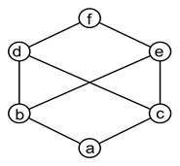
QUESTIONS:
2. The graph given below is an example of _________
a) non-lattice poset
b) semilattice
c) partial lattice
d) bounded lattice
Answer: a
Explanation: The graph is an example of non-lattice poset where b and c have common upper bounds d, e and f but none of them is the least upper bound.

Slide 5
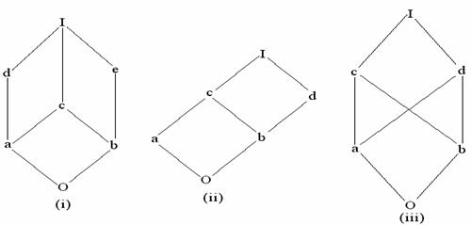
QUESTIONS:
3. How to recognize which lattices are distributive or not only by looking on their diagrams? Is it even possible?
Yes, it's possible. A lattice is distributive if and only if it does not contain the diamond lattice or the pentagon lattice as a sublattice

Slide 6
QUESTIONS:
4.

